Slide 1

Healthcare Data Preprocessing & Train-Test Split
A comprehensive approach to transforming raw healthcare data into machine learning-ready datasets involves systematic preprocessing steps such as handling missing values, cleaning inconsistent entries, converting categorical and date fields into structured formats, and applying train-test splits. This ensures that healthcare data, which is often complex and incomplete, becomes clean, reliable, and optimized for analysis, predictions, and the development of AI-driven healthcare applications.
Project Team :
Shivam
Sai Tejaswi
PoobeshRaj
Jahnavi Lakshmi

Slide 2
Project Introduction
Healthcare Data Challenges
Data Quality Issues
Our project addresses the fundamental challenge of working with raw healthcare datasets that typically contain patient demographics, admission and discharge records, diagnostic information, and billing details. These datasets, whilst rich in clinical information, often arrive in formats that are unsuitable for direct analysis or machine learning applications.
Raw healthcare data is frequently incomplete, containing missing values, inconsistent formatting, and categorical variables that require systematic encoding
Analysis Requirements
The preprocessing pipeline we've developed transforms these complex, often inconsistent datasets into clean, structured formats that enable robust statistical analysis and predictive modelling capabilities essential for healthcare data science applications.
Machine learning models require clean, numerical data with proper feature encoding to generate accurate predictions and meaningful insights

Slide 3




Project Objectives
Data Transformation
Convert raw healthcare datasets into clean, structured formats suitable for analysis. This involves standardising data types, formats, and ensuring consistency across all records in the dataset.
Data Quality Enhancement
Systematically handle missing values through appropriate imputation strategies, perform categorical variable encoding, and convert date fields into standardised datetime formats for temporal analysis.
ML Preparation
Prepare the dataset for machine learning applications by implementing proper train-test splitting methodologies, ensuring data integrity, and creating reproducible preprocessing pipelines.
Output Management
Generate clean, processed datasets saved in appropriate formats for future research applications, model training, and validation processes within healthcare analytics workflows.

Slide 4
Team Roles & Responsibilities
1
2
Data Loading & Initial Exploration
Missing Values & Date Processing
Responsible for importing healthcare datasets, conducting initial data profiling, identifying data quality issues, and documenting dataset characteristics including schema, data types, and preliminary statistical summaries.
Handles systematic treatment of missing data using appropriate imputation strategies, converts date fields to standardised formats, and ensures temporal consistency across admission and discharge records.
Missing data imputation strategies
Dataset import and validation
Date format standardisation
Initial exploratory data analysis
Temporal data validation
Data quality assessment
3
4
Encoding & Data Cleaning
Model Preparation & Documentation
Implements categorical variable encoding techniques, cleans numerical fields such as billing amounts, and ensures all data types are appropriate for machine learning model consumption.
Executes train-test dataset splitting, manages output file generation, and maintains comprehensive documentation of all preprocessing steps and methodological decisions.
Categorical variable encoding
Train-test split implementation
Numerical data cleaning
Output file management
Feature engineering preparation
Process documentation

Slide 5






Data Processing Workflow
Our systematic approach to healthcare data preprocessing follows a structured pipeline that ensures data quality and machine learning readiness.
Raw Data Ingestion
Data Cleaning
Import healthcare dataset containing patient records, admission details, and billing information
Remove inconsistencies, standardise formats, and identify data quality issues requiring attention
Missing Value Treatment
Categorical Encoding
Apply appropriate imputation strategies for missing discharge dates and test results
Transform categorical variables into numerical representations suitable for ML algorithms
Train-Test Split
Processed Dataset
Divide processed dataset into training and testing subsets for model development
Generate clean, ML-ready dataset saved for future analysis and model training

Slide 6
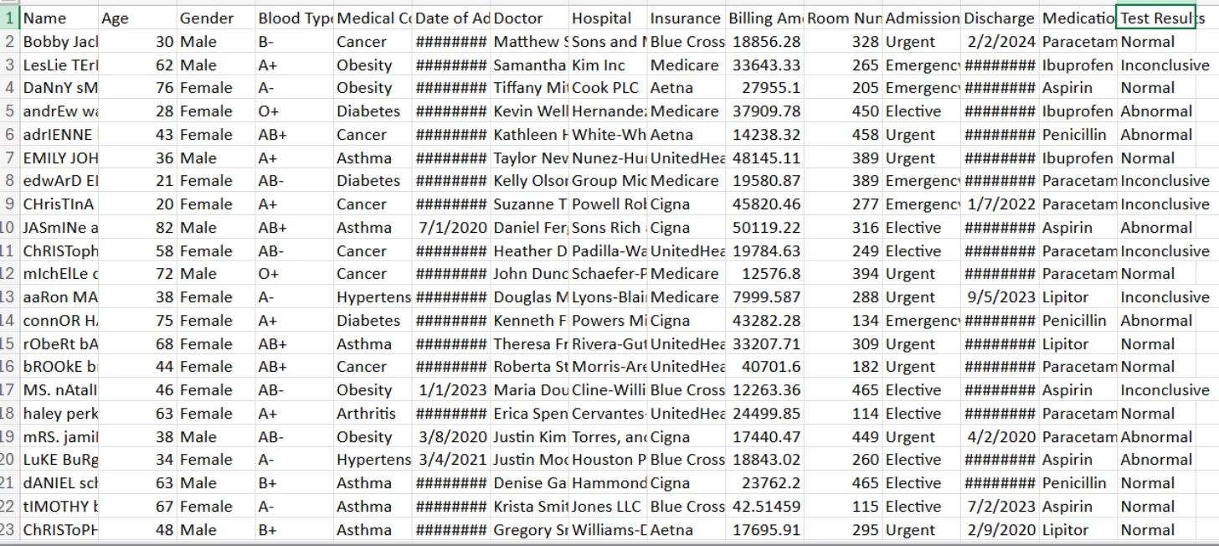
Raw Dataset Characteristics
Original Healthcare Dataset
Missing Discharge Dates
The raw healthcare dataset presents several typical challenges found in real-world medical data. Our analysis identified critical data quality issues that required systematic attention before any meaningful analysis could be conducted.
Approximately 15% of patient records lacked discharge date information, affecting length of stay calculations
Incomplete Test Results
Test result fields contained significant gaps, with missing values distributed across various diagnostic categories
Inconsistent Billing Format
Billing amounts included currency symbols and inconsistent decimal formatting, preventing numerical analysis
Categorical Encoding Issues
Gender and test result categories required systematic encoding for machine learning compatibility

Slide 7
Comprehensive Preprocessing Steps
Our data preprocessing pipeline addresses each identified data quality issue through systematic, reproducible methodologies that maintain clinical relevance whilst ensuring machine learning compatibility.
Date Standardisation
1
Converted all admission and discharge dates to standardised datetime format, enabling temporal analysis and length of stay calculations. This step ensures consistency across all temporal variables in the dataset.
2
Missing Value Imputation
Implemented strategic missing data handling: discharge dates were imputed using average stay duration calculations, whilst test results were filled using modal values to maintain clinical plausibility.
Numerical Data Cleaning
3
Systematically cleaned billing amount fields by removing currency symbols and standardising decimal representations, converting all monetary values to consistent floating-point numerical format.
4
Categorical Variable Encoding
Applied label encoding to binary gender variables and one-hot encoding to multi-category test results, ensuring all categorical information is preserved whilst maintaining ML algorithm compatibility.

Slide 8
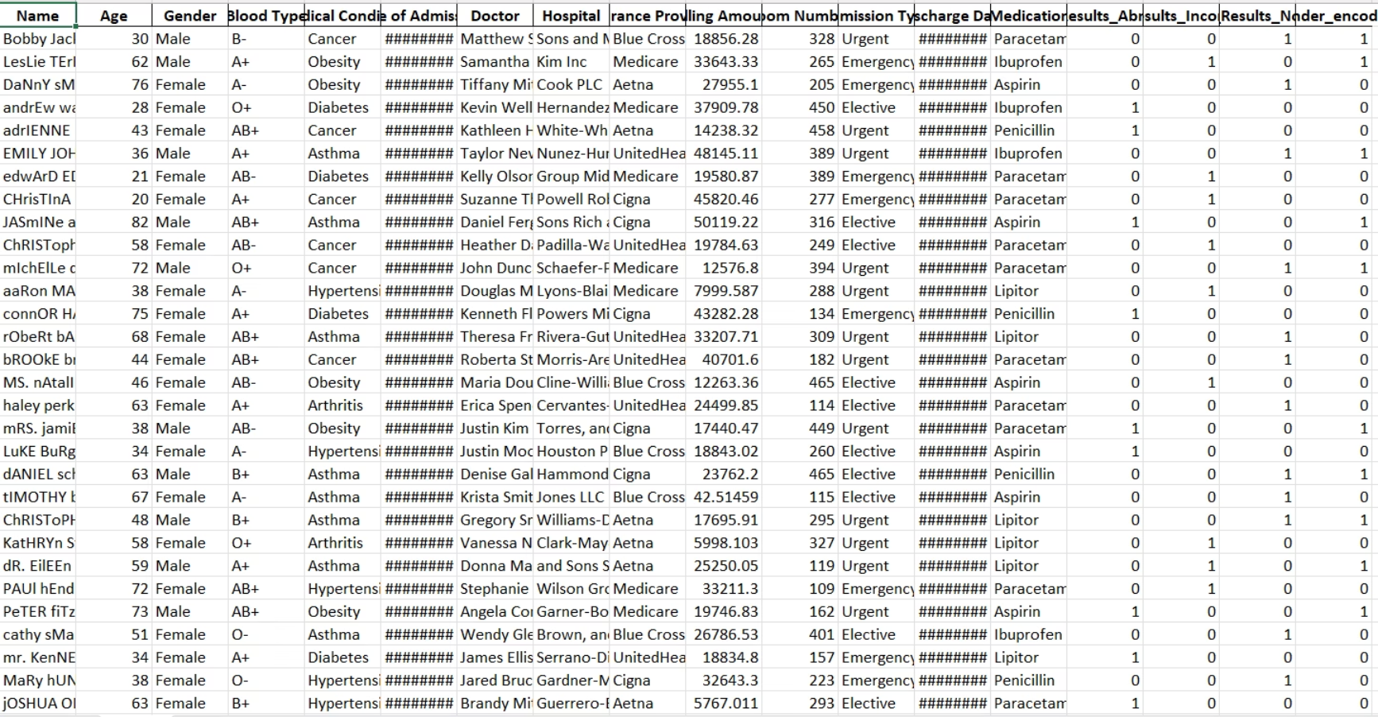
Processed Dataset Results
Clean Healthcare Dataset
The processed dataset demonstrates significant improvement in data quality and structure. All missing values have been addressed through appropriate imputation strategies, numerical fields are properly formatted, and categorical variables are encoded for machine learning applications.
This transformation enables robust statistical analysis, predictive modelling, and ensures reproducible research outcomes in healthcare analytics applications.
Complete data coverage with no missing values
Standardised numerical formatting across all fields
Properly encoded categorical variables
Machine learning-ready data structure
Consistent data types across all features
Outliers and anomalies identified and addressed
Engineered new features to enhance model performance
100%
6
80/20
Data Completeness
Processing Steps
Train-Test Split
All missing values successfully imputed using clinically appropriate methodologies
Comprehensive pipeline covering all aspects of healthcare data preprocessing
Standard machine learning data division for model development and validation

Slide 9


Key Techniques & Methodologies
Our healthcare data preprocessing approach employs established statistical and machine learning methodologies to ensure data quality and analytical validity.
Average Stay Duration
Missing Date Imputation
Statistical calculation used for imputing missing discharge dates based on historical patient stay patterns
Systematic approach to filling missing discharge dates using clinically appropriate duration estimates
Modal Value Imputation
Train-Test Data Split
Statistical method for imputing missing categorical test results using the most common diagnostic outcome
Standard machine learning practice ensuring robust model validation and performance assessment capabilities

Slide 10




Impact & Advantages of Preprocessing
Our comprehensive data preprocessing strategy delivers significant benefits, transforming raw, complex healthcare data into reliable, machine learning-ready assets that drive accurate insights and enhance decision-making.
Enhanced Accuracy
Improved Reliability
Clean and consistent data ensures higher precision and reliability of analytical models and predictions.
Systematic handling of missing values and inconsistencies reduces data noise, leading to more trustworthy results.
Greater Reproducibility
Informed Decision-Making
Standardised methodologies enable consistent data preparation, ensuring research and model outcomes are repeatable.
High-quality data supports better clinical and operational decisions, improving patient care and resource allocation.

Slide 11
Thank You

